Slide 1
A Natural Language Chatbot for Excel-Based Insights
Adinarayana Thota

Slide 2

Project Overview
Title: A Natural Language Chatbot for Excel-Based Insights
. Objective: Build an interactive chatbot to analyze Excel datasets using natural language and Streamlit
Tech Stack: Gemini, Streamlit UI, Pandas , Python

Slide 3


Understanding AI Assistant for Excel
A smart, conversational interface that enables users to explore Excel spreadsheets using natural language — no coding or formulas required. ⏱️ Saves Time: No need for manual filtering
🧑‍💼 Empowers Non-Tech Users: Business-friendly interaction
📈 Instant Insights: From raw spreadsheets to ready answers

Slide 4
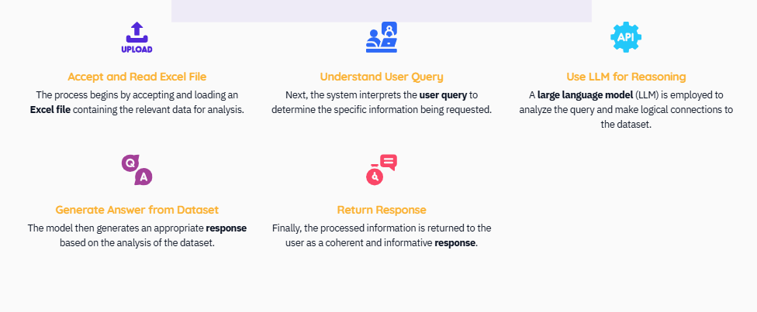
Overview of Working Process

Slide 5

Process of Accepting Excel Files
Receive a .xlsx file The initial step involves accepting a .xlsx file from the user, which serves as the primary data source.
Load file using parser Utilize a parser like pandas.read_excel to load data from the received Excel file into a usable format.
Normalize and clean data Ensure the data is normalized, cleaning column names and inferring appropriate column types for analysis.
Handle missing values Implement strategies to handle missing values gracefully, ensuring data integrity during analysis.

Slide 6
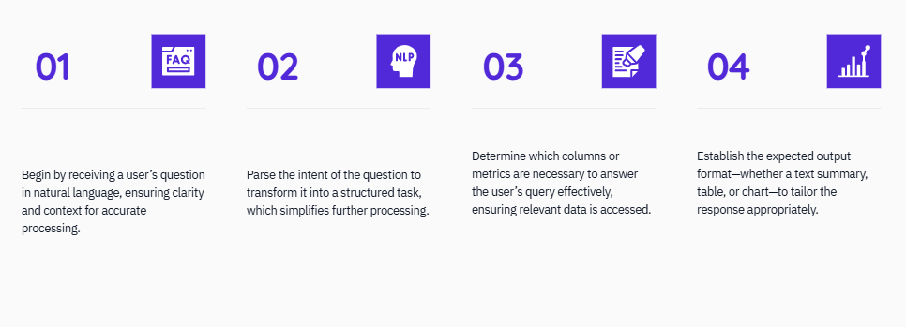
Understanding User Queries in Excel

Slide 7
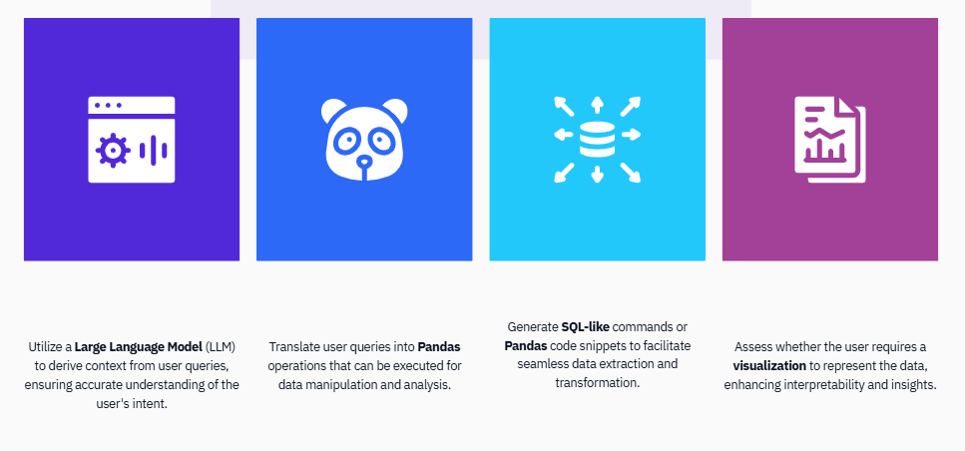
Leveraging LLM for Excel Analysis

Slide 8
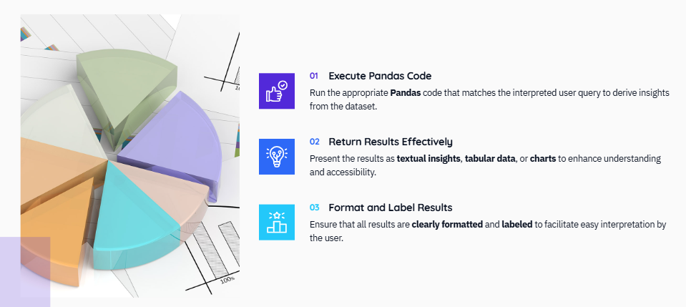
Generating Answers from Datasets

Slide 9
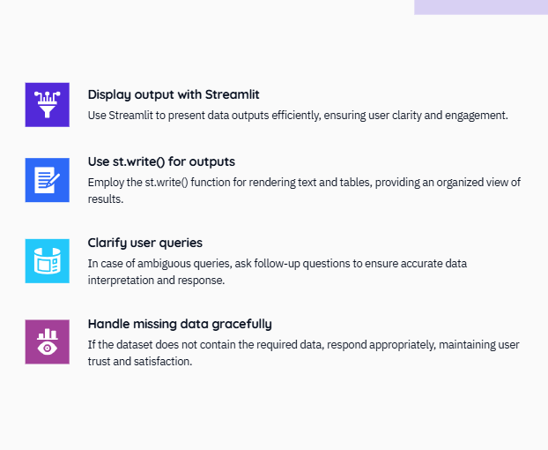
Presenting Outputs in Streamlit

Slide 10
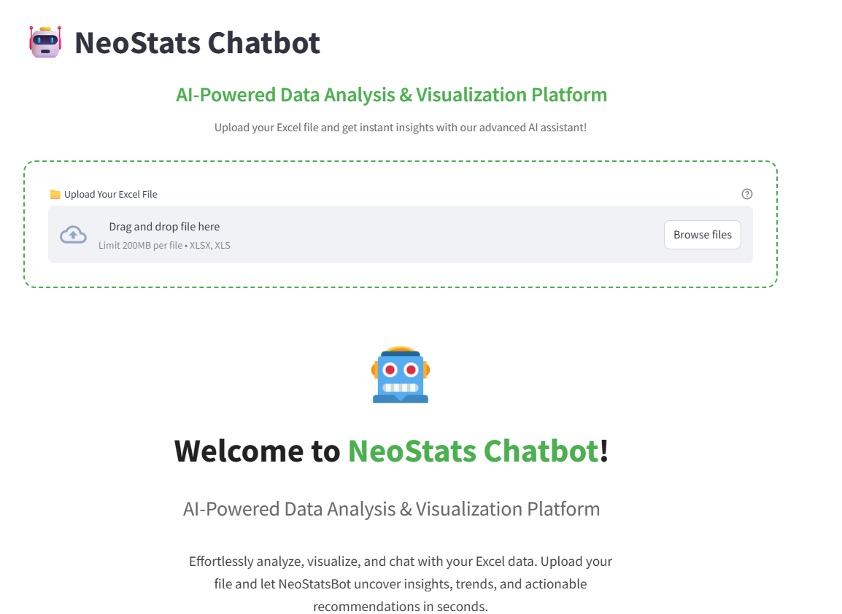
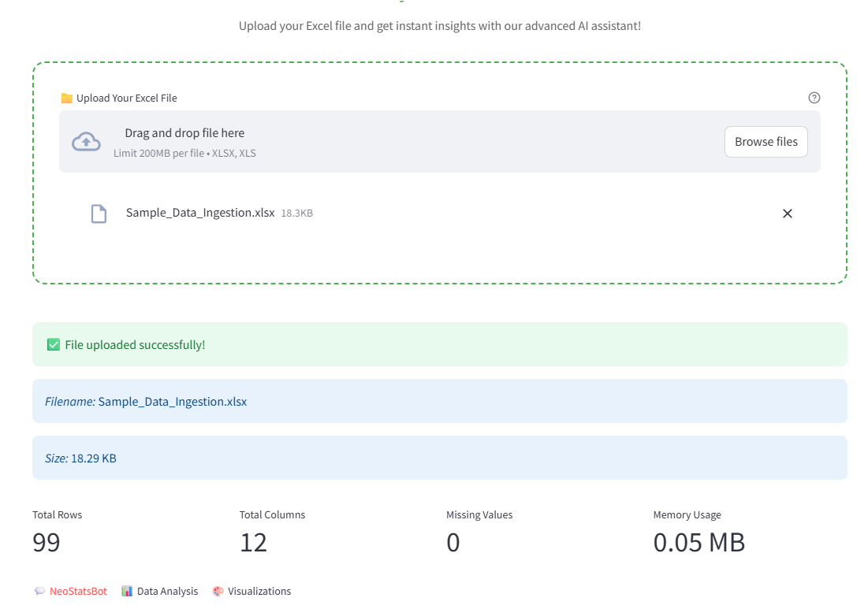
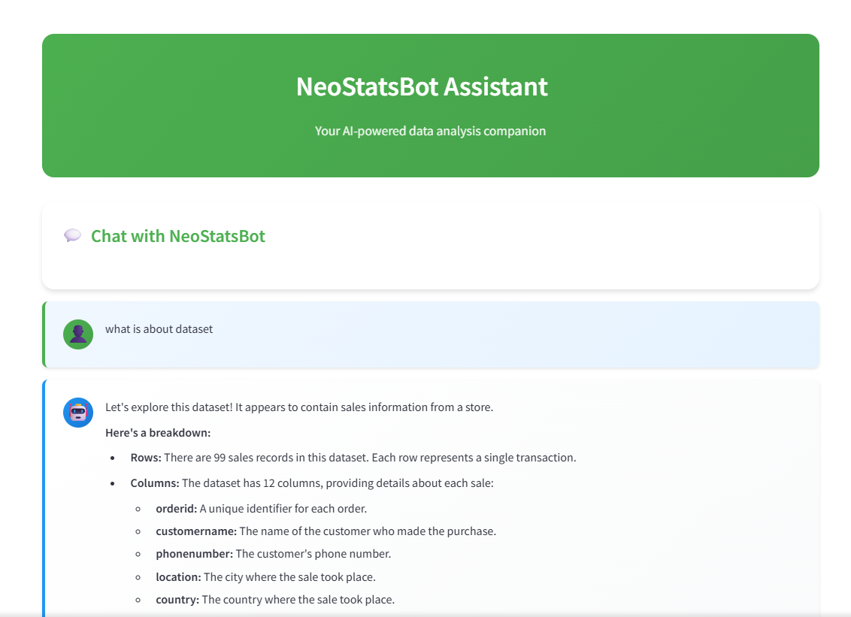
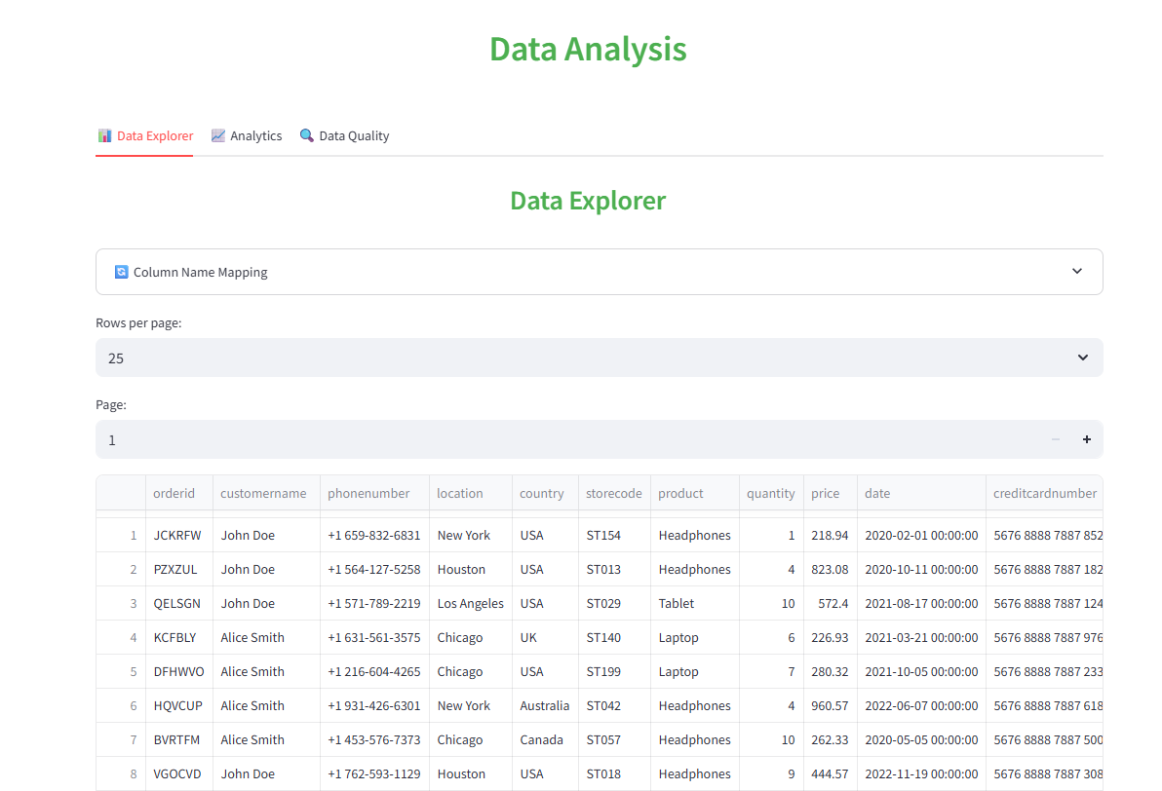
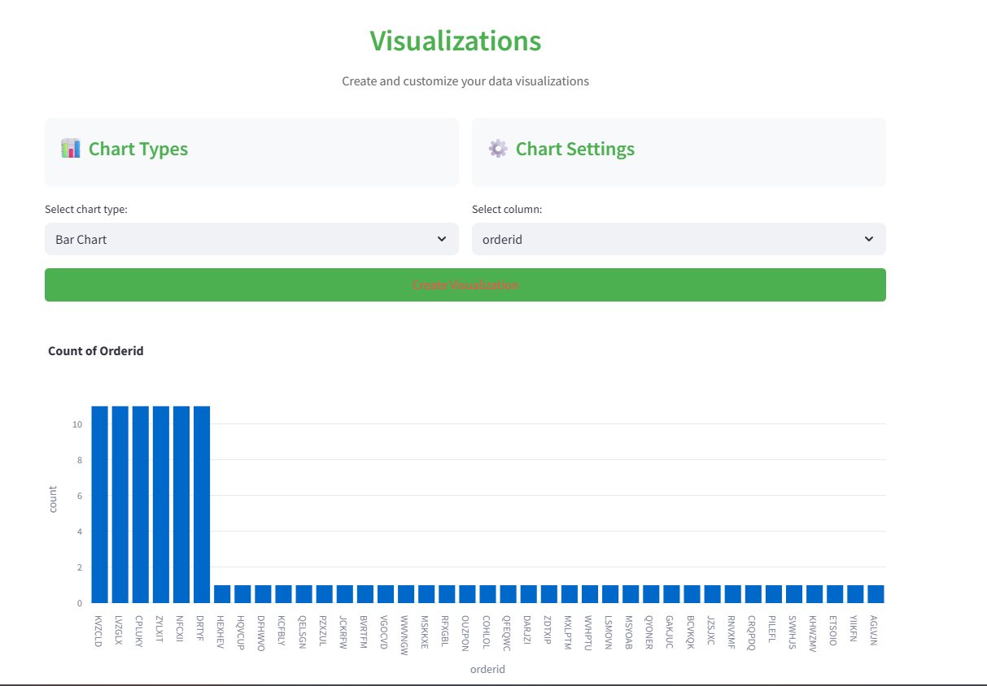
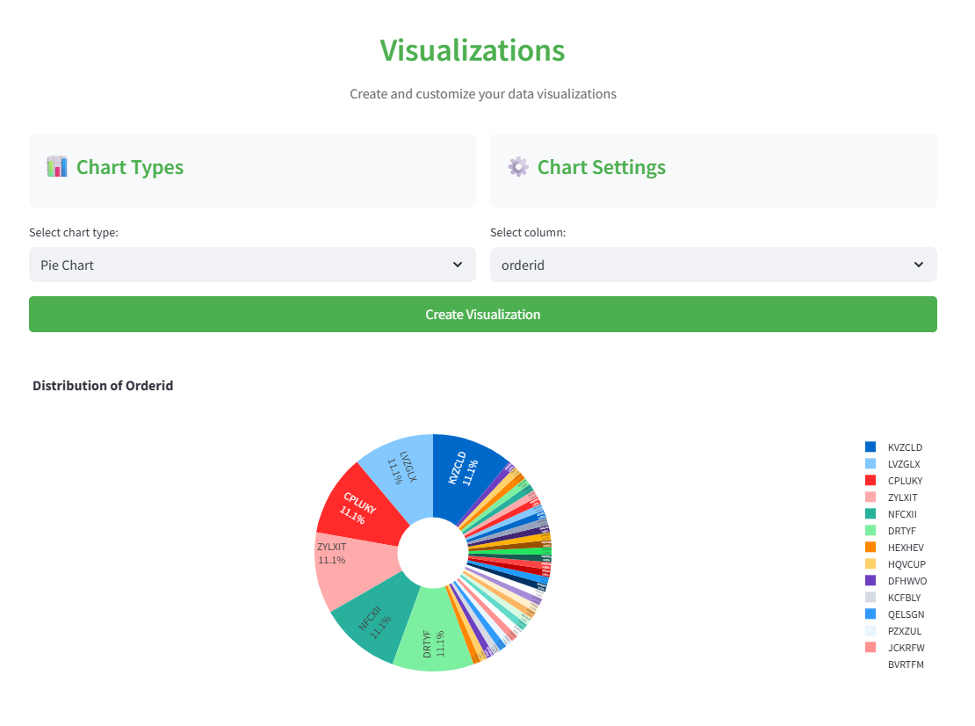
Sample Output

Slide 11

Challenges
Gemini sometimes hallucinates answers
Need to restrict LLM to code generation only
Must sanitize inputs and outputs

Slide 12

CONCLUSION
A working chatbot that turns Excel data into actionable insights
Combines LLM reasoning + Python execution Easy for non-programmers to use

Slide 13

THANK YOU

